Slide 1
NATURE BASED SOLUTIONS FOR CLIMATE CHANGE
GROUP 24

Slide 2
OUTLINE
Introduction
What are Nature-based solutions?
Types of Nature-based solutions
Benefits of Nature-based solutions
Challenges and limitations
Policies and Global initivatives that have supported these solutions
Conclusion

Slide 3
INTRODUCTION
Climate change is a pressing global challenge, impacting ecosystems, biodiversity, and human livelihood. To combat this issue, we turn to Nature-based Solutions (NBS). In this presentation, we'll explore the importance and benefits of NBS.

Slide 4
WHAT IS NBS?
Nature-based Solutions refer to sustainable strategies that work with nature to address climate change impacts. These solutions promote the restoration and conservation of natural habitats, supporting both people and the planet.

Slide 5
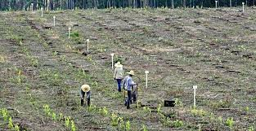
TYPES OF NATURE-BASED SOLUTIONS
Forest restoration
Wetland restoration
Green infrastructure
Sustainable agriculture
Figure 1: Forest restoration

Slide 6

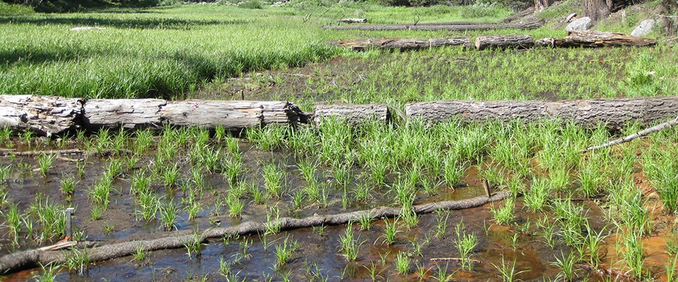
TYPES OF NATURE-BASED SOLUTIONS
Coastal ecosystems
Figure 2: Wetland restoration
Figure 3: Green infrastructure

Slide 7


TYPES OF NATURE-BASED SOLUTIONS
Figure 4: Sustainable agriculture
Figure 5: Coastal ecosystem

Slide 8
BENEFITS
Climate mitigation
Climate adaptation
Biodiversity conservation

Slide 9
CASE STUDY(Green infrastructure in Singapore)
Singapore’s innovative and strategic integration of nature based solutions combats urbanization and climate change, yielding a greener resilient city.
Urban diversity and green spaces
Rooftop gardens and green walls
Sustainable drainage systems

Slide 10
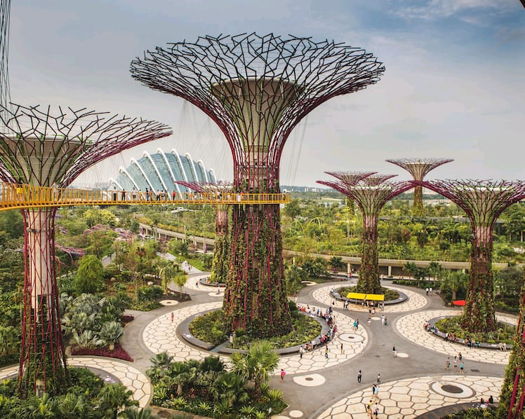
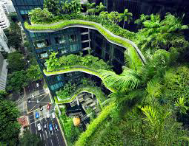
Green infrastructure in Singapore
Supertrees
Rooftop gardens

Slide 11

Green infrastructure in Singapore
Sustainable drainage systems

Slide 12
CHALLENGES
Funding constraints
Policy barriers
Social awareness

Slide 13
POLICIES THAT HAVE SUPPORTED NBS
The Paris Agreement:
It was adopted in 2015 and signed by 196 countries.
Its central goal is to limit global warming to well below 2 degrees Celsius above pre-industrial levels, with efforts to limit it to 1.5 degrees Celsius.
The agreement promotes NBS as one of the key strategies to achieve emission reductions and enhance climate resilience.

Slide 14
POLICIES AND INITIATIVES
The UN Decade on Ecosystem Restoration (2021-2030):
The UN declared 2021-2030 as the Decade on Ecosystem Restoration.
This initiative aims to ramp up global efforts in restoring ecosystems, including forests, wetlands, grasslands, and other natural habitats.
NBS are integral to achieving the objectives of the UN Decade by promoting sustainable land use practices and enhancing ecosystem health.

Slide 15
POLICIES AND INITIATIVES
National and Regional Policy Frameworks:
Many countries and regions have developed specific policies and frameworks to promote NBS implementation.
These policies may include financial incentives, regulatory support, and capacity-building programs to encourage stakeholders to adopt NBS strategies.

Slide 16
POLICIES AND INiTIATIVES
Corporate and Non-Governmental Initiatives:
Corporations and non-governmental organizations (NGOs) are actively taking part in supporting and implementing NBS.
Companies are integrating nature-based approaches into their sustainability strategies, while NGOs often lead local restoration projects and awareness campaigns.

Slide 17
POLICIES AND INITIATIVES
Engaging communities
Engaging local communities is vital for the success of NBS. Ways by which this can be done include:
Community-led Reforestation Projects
Participatory Wetland Restoration Initiatives
Urban Greening Programs with Citizen Involvement

Slide 18
CONCLUSION
Nature-based Solutions offer a sustainable and effective approach to combat climate change, while promoting biodiversity and supporting human well-being. Embracing NBS will lead us towards a more resilient and greener future for generations to come.

Slide 19
REFERENCES
"Nature-Based Solutions - European Commission". Archived from the original on 23 September 2019. Retrieved 10 December 2019.
Wild, Tom; Freitas, Tiago; Vandewoestijne, Sofie (2020). Nature-based Solutions - State of the Art in EU-funded Projects (PDF). Archived (PDF) from the original on 11 January 2021. Retrieved 11 January 2021.
Eggermont, Hilde; Balian, Estelle; Azevedo, José Manuel N.; Beumer, Victor; Brodin, Tomas; Claudet, Joachim; ed 5 September 2021

